Slide 1
Developing a contextually-specific, digital intervention for alcohol reduction Dr Melissa Oldham
Behavioural Science and health
Notes:
Hello everybody, I am Melissa Oldham I am a senior research fellow at University College London and I am so pleased to be here today. The work I will be presenting is focused on developing contextually specific intervention components within an existing digital intervention, the Drink Less app.

Slide 2
Funding
This study was funded by the Medical Research Council (MR/W026430/1).The views expressed are those of the authors and not necessarily those of the MRC.
I have done paid consultancy work for the behaviour change and lifestyle organization, ‘One Year No Beer’, providing fact checking for blog posts.
Conflicts of interest
Notes:
I would like to start with various acknowledgements in relation to the work that we’ll be presenting on today.
First to our funder, the Medical Research Council

Slide 3
TIDDLES team
Melissa Oldham
Claire Garnett
Larisa Dinu
Abigail Stevely
John Holmes
Andrew Jones
Notes:
To the whole study team who have contributed their big brains to this project.

Slide 4
The problem
Record high alcohol deaths in the UK¹
Leading risk factor for early mortality, ill health and disability²
Exacerbated by COVID-19 pandemic³
34% of these tried to cut down in the past year
At risk drinkers
32% of population⁴
9% of these used support
1.ONS data retrieved from; https://www.ons.gov.uk/peoplepopulationandcommunity/birthsdeathsandmarriages/deaths/bulletins/alcoholspecificdeathsintheuk/2021registrations
2. Griswold MG et al. Alcohol use and burden for 195 countries and territories, 1990–2016: a systematic analysis for the Global Burden of Disease Study 2016 The Lancet;392:1015–35. (2018).
3. Oldham et al. Characterising the patterns of and factors associated with increased alcohol consumption since COVID-19 in a UK sample. Drug and Alcohol review; DOI: https://doi.org/10.1111/dar.13256 (2021).
4. ATS data retrieved from https://www.alcoholinengland.info/graphs/monthly-tracking-kpi
Notes:
So to the project…
In 2021, over 9,000 people in the UK died as a direct consequence of their alcohol consumption, which was a record-high​
The harms of alcohol have been further exacerbated by the COVID pandemic, with increases in the prevalence of at-risk drinking since the first lockdown. ​
​
In England around a third of the population are drinking at levels which mean they are at increasing-risk of harm from their drinking though less than half of these have made a past year attempt to cut down, and only 9% of at-risk drinkers who recorded an attempt to cut down in the last year used support. This means that only a small minority of people who would benefit from drinking less alcohol are attempting to do so with support. ​
​
​
​

Slide 5
Harmful drinking occurs in a variety of contexts…
Common types of drinking occasions in the UK¹;
At home with partner
With partner/family at home
Social event in a home
Pub with friends
Pub alone
Big day/night out
Going out for a meal
Going out with partner
1. Holmes J, Sasso A, Hernandes Alava M, Borges Neves R, Stevely AK, Wardle A, M. P. The distribution of alcohol consumption and heavy episodic drinking across British drinking occasions in 2019: An event-level latent class analysis of drinking diary data. Addiction 12–26 (in press).
Notes:
The contexts in which people drink and their reasons for drinking are highly variable. In the UK drinking at risky levels occurs in a wide range of contexts, these were collated in a recent paper and I have listed some of the most common types of drinking occasions here to give you a sense of what I am talking about when I mention contexts.​

Slide 6
Drinking contexts matter…
Drinking is not conceptualised in terms of a weekly total, but as individual occasions that are differentially integral to peoples lives^{1,2}
A range of contextual factors to heavy drinking occasions including drinking within a large group and drinking at the weekend^{3,4}
1. Lyons, A. C., Emslie, C. & Hunt, K. Staying ‘in the zone’ but not passing the ‘point of no return’: Embodiment, gender and drinking in mid-life. Sociol. Heal. Illn. 36, 264–277 (2014). 2. Aresi, G. & Pedersen, E. R. ‘That right level of intoxication’: A Grounded Theory study on young adults’ drinking in nightlife settings. J. Youth Stud. 19, 204–220 (2016). 3. Thrul, J. & Kuntsche, E. The impact of friends on young adults’ drinking over the course of the evening-an event-level analysis. Addiction 110, 619–626 (2015). 4. Thrul, J., Labhart, F. & Kuntsche, E. Drinking with mixed-gender groups is associated with heavy weekend drinking among young adults. Addiction 112, 432–439 (2017).
Notes:
Theoretical and empirical studies increasingly highlight the importance of viewing alcohol consumption as an event, occasion or practice-level phenomenon
Previous research suggests people do not conceptualise their drinking in terms of a weekly total, but as individual occasions that are differentially integral to their daily lives
Previous studies have linked a range of contextual factors to heavy drinking occasions including drinking within a large group and drinking at the weekend.

Slide 7
Different kinds of drinking might need different kinds of reduction strategies…
Some drinking contexts may be more modifiable than others
Strategies for cutting down may be differentially effective for different occasion types
Personalising intervention strategies to contexts may be more effective than ‘one-size-fits-all’ approaches
Notes:
So taken together these studies show us that drinking contexts matter. However, existing interventions tend to focus on reducing alcohol consumed regardless of drinking context, but it is likely that some drinking contexts are more modifiable than others, and that strategies for cutting down will be differentially effective for different occasion types. As such, personalising intervention strategies to individuals’ drinking contexts and the contexts in which individuals drink to harmful levels will be more effective than ‘one-size-fits-all’ approaches.

Slide 8
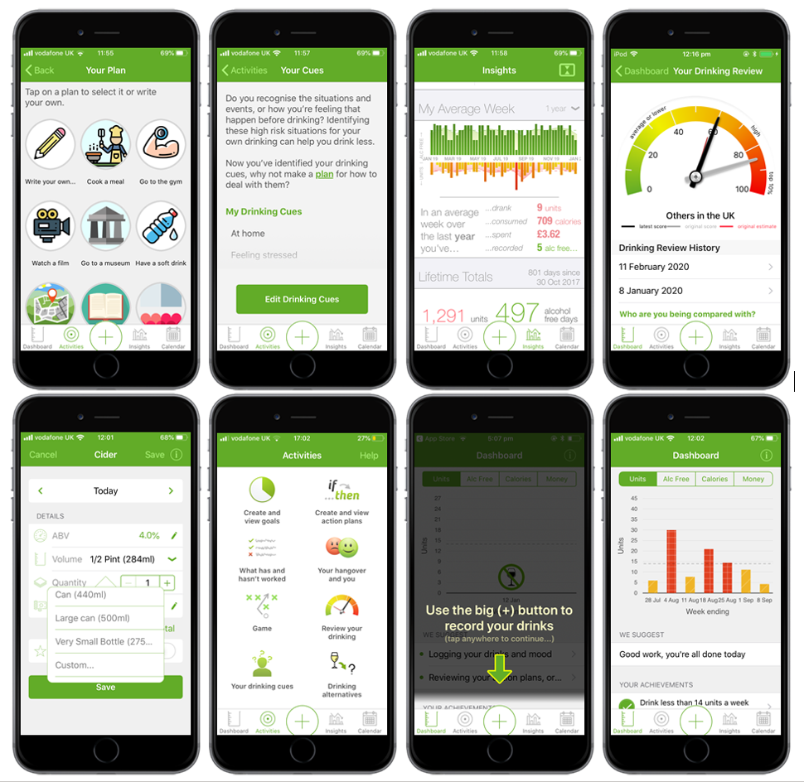
The Drink Less app
Goal setting
Self-monitoring & Feedback
Normative Feedback
Action Planning
Cognitive Bias Re-training
Insights
Information about Antecedents
Behavioural Substitution
Notes:
This project aims to improve the efficacy of the established digital intervention ‘Drink Less’. Drink Less is an app that seeks to reduce alcohol consumption amongst increasing and higher risk drinkers to achieve short- and long-term improvements in population health across the socio-economic spectrum.
The Drink Less app is an evidence and theory informed app developed by researchers at UCL with the aim of helping heavier drinkers reduce their alcohol consumption.
The app has a number of intervention components:
Goal setting - where users can set their own weekly goals based on units, cost, alcohol free days or calories.
Self-monitoring & feedback – which prompts users to track their drinking and provides feedback on their progress
Normative Feedback – where users receive feedback on their drinking relative to others
Action Planning - helps users create if, then plans to avoid heavy drinking
CBR - a game to retrain approach-avoidance bias for alcoholic drinks
Insights - where users can see their overall progress and running totals by week or month
Information about antecedents - prompts users to identify the situations and events, or feelings that occur before drinking, named ‘Drinking Cues’ in the app
Behavioural substitution - prompts users to make an alternative plan within the drinking calendar on the app, named ‘Drinking Alternatives’ in the app

Slide 9
The Drink Less app
Goal setting
Self-monitoring & Feedback
Normative Feedback
Action Planning
Cognitive Bias Re-training
Insights
Information about Antecedents
Behavioural Substitution
Notes:
This project aims to improve the efficacy of the established digital intervention ‘Drink Less’ by modifying it to be more context-specific. The app will be modified to measure contextual characteristics of drinking occasions (e.g. location, company) using a drinking diary.
Components are…
Two existing intervention components, Self-Monitoring & Feedback and Action Planning will then be adapted, so that they are personalised to the users’ drinking contexts.

Slide 10
To achieve this we need to….
Establish best way to measure drinking contexts within the existing drinking diary.
Develop context-specific messaging for both the self-monitoring and feedback and action planning intervention components
Refine this messaging with;
Potential users (increasing and higher risk drinkers AUDIT≥8)
Experts in behaviour change
App developer
Notes:
This project aims to improve the efficacy of the established digital intervention ‘Drink Less’. Drink Less is an app that seeks to reduce alcohol consumption amongst increasing and higher risk drinkers to achieve short- and long-term improvements in population health across the socio-economic spectrum. The app will be modified to measure contextual characteristics of drinking occasions (e.g. location, company) using a drinking diary. Two existing intervention components, Self-Monitoring & Feedback and Action Planning will then be adapted, so that they are personalised to the users’ drinking contexts.

Slide 11
In order to achieve this we need to….
Establish best way to measure drinking occasion type withing the existing drinking diary.
Develop context-specific messaging for both the self-monitoring and feedback and action planning intervention components
Refine this messaging with;
Potential users (increasing and higher risk drinkers AUDIT≥8)
Experts in behaviour change
App developer
Notes:
This project aims to improve the efficacy of the established digital intervention ‘Drink Less’. Drink Less is an app that seeks to reduce alcohol consumption amongst increasing and higher risk drinkers to achieve short- and long-term improvements in population health across the socio-economic spectrum. The app will be modified to measure contextual characteristics of drinking occasions (e.g. location, company) using a drinking diary. Two existing intervention components, Self-Monitoring & Feedback and Action Planning will then be adapted, so that they are personalised to the users’ drinking contexts.

Slide 12
Aim 1 – Measuring drinking contexts
Notes:
So the first aim is working out how

Slide 13
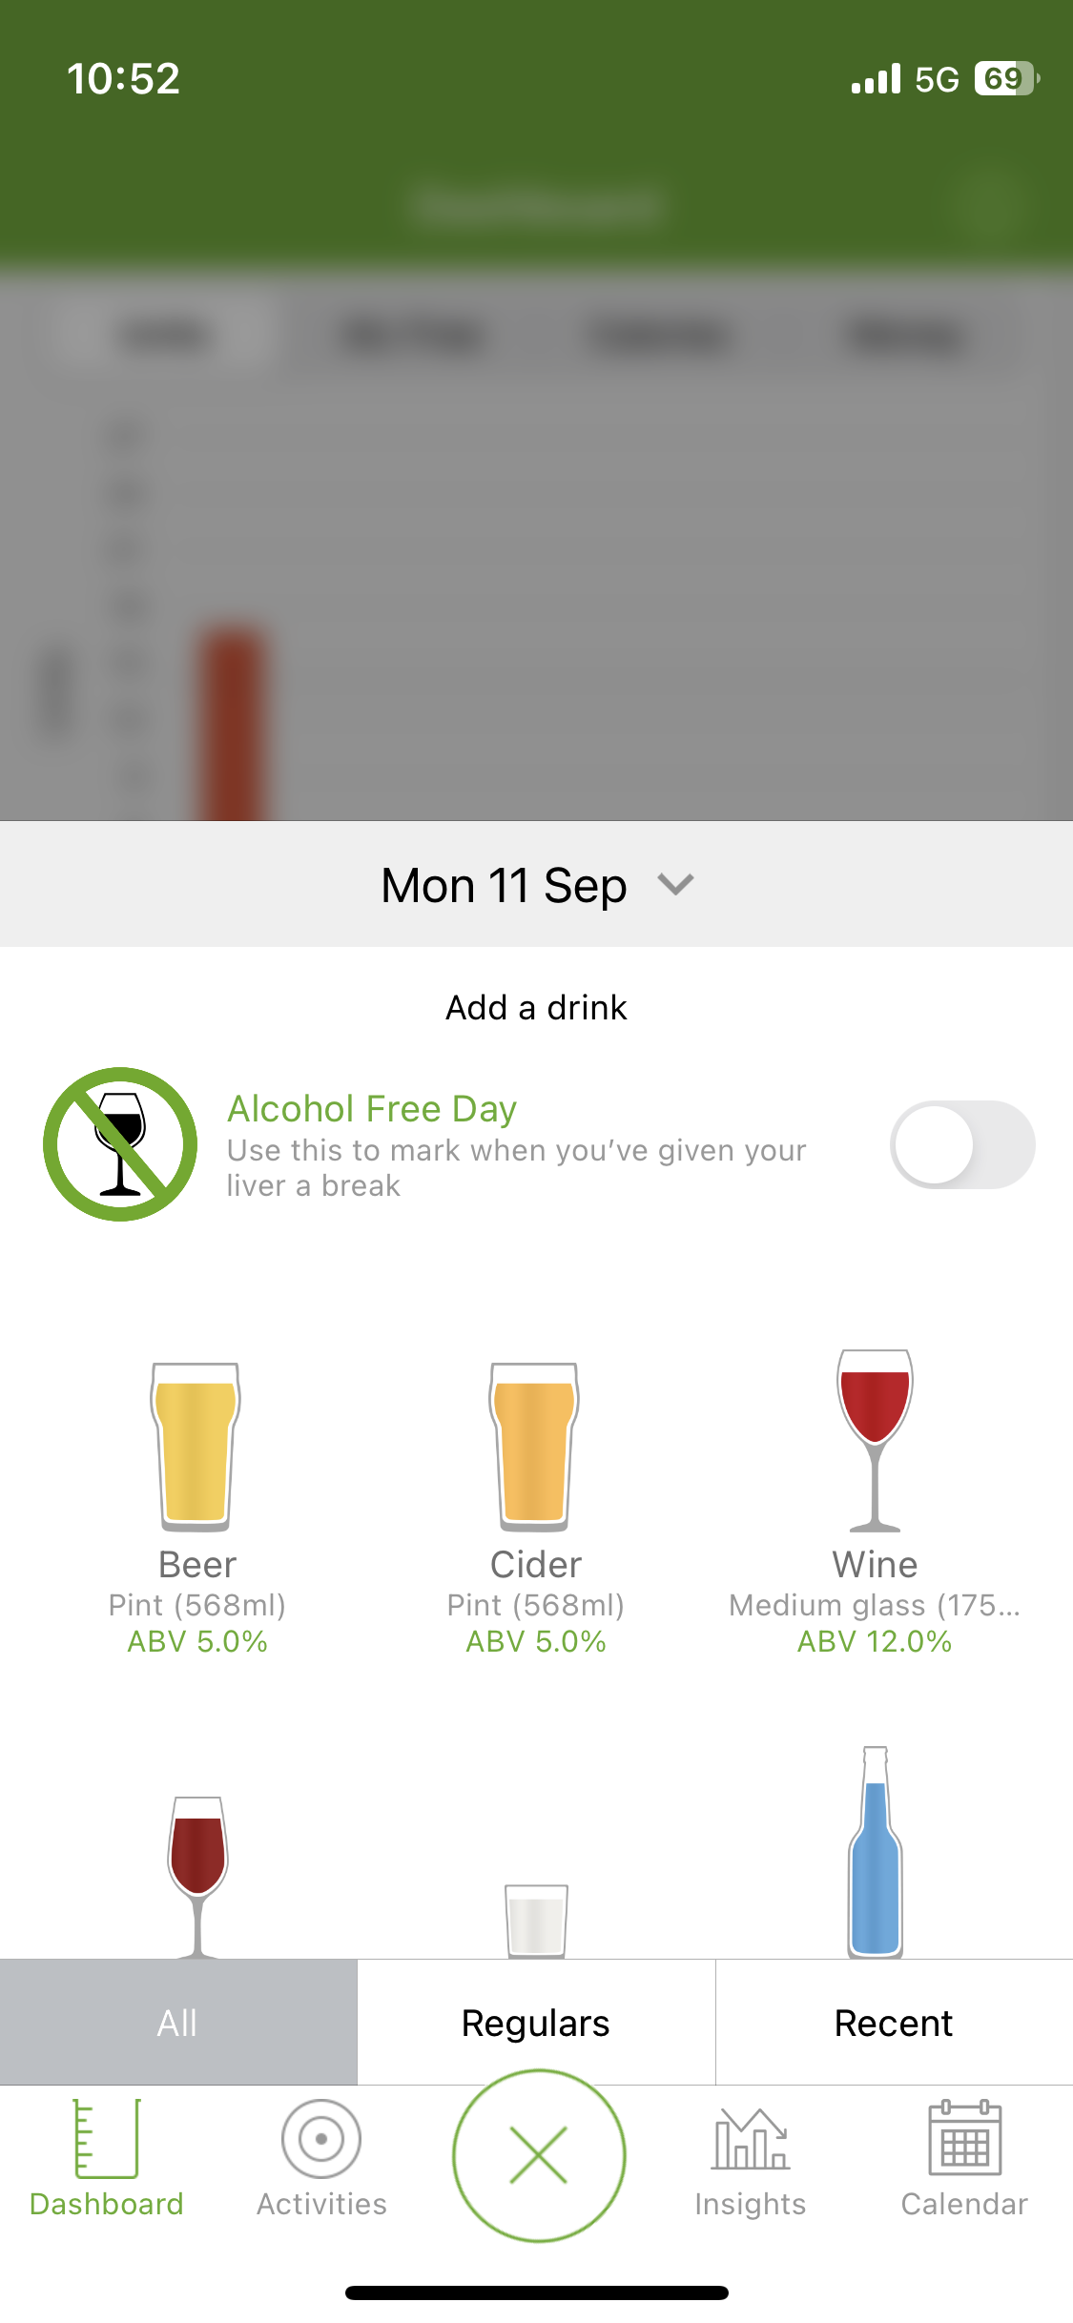
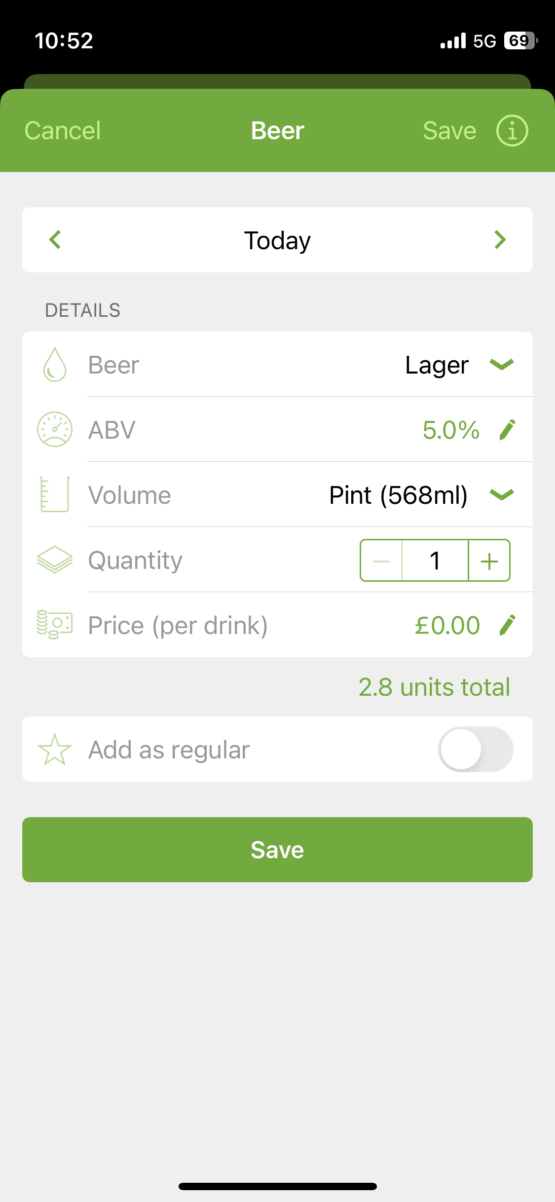
Drinking diary currently looks like…

Slide 14
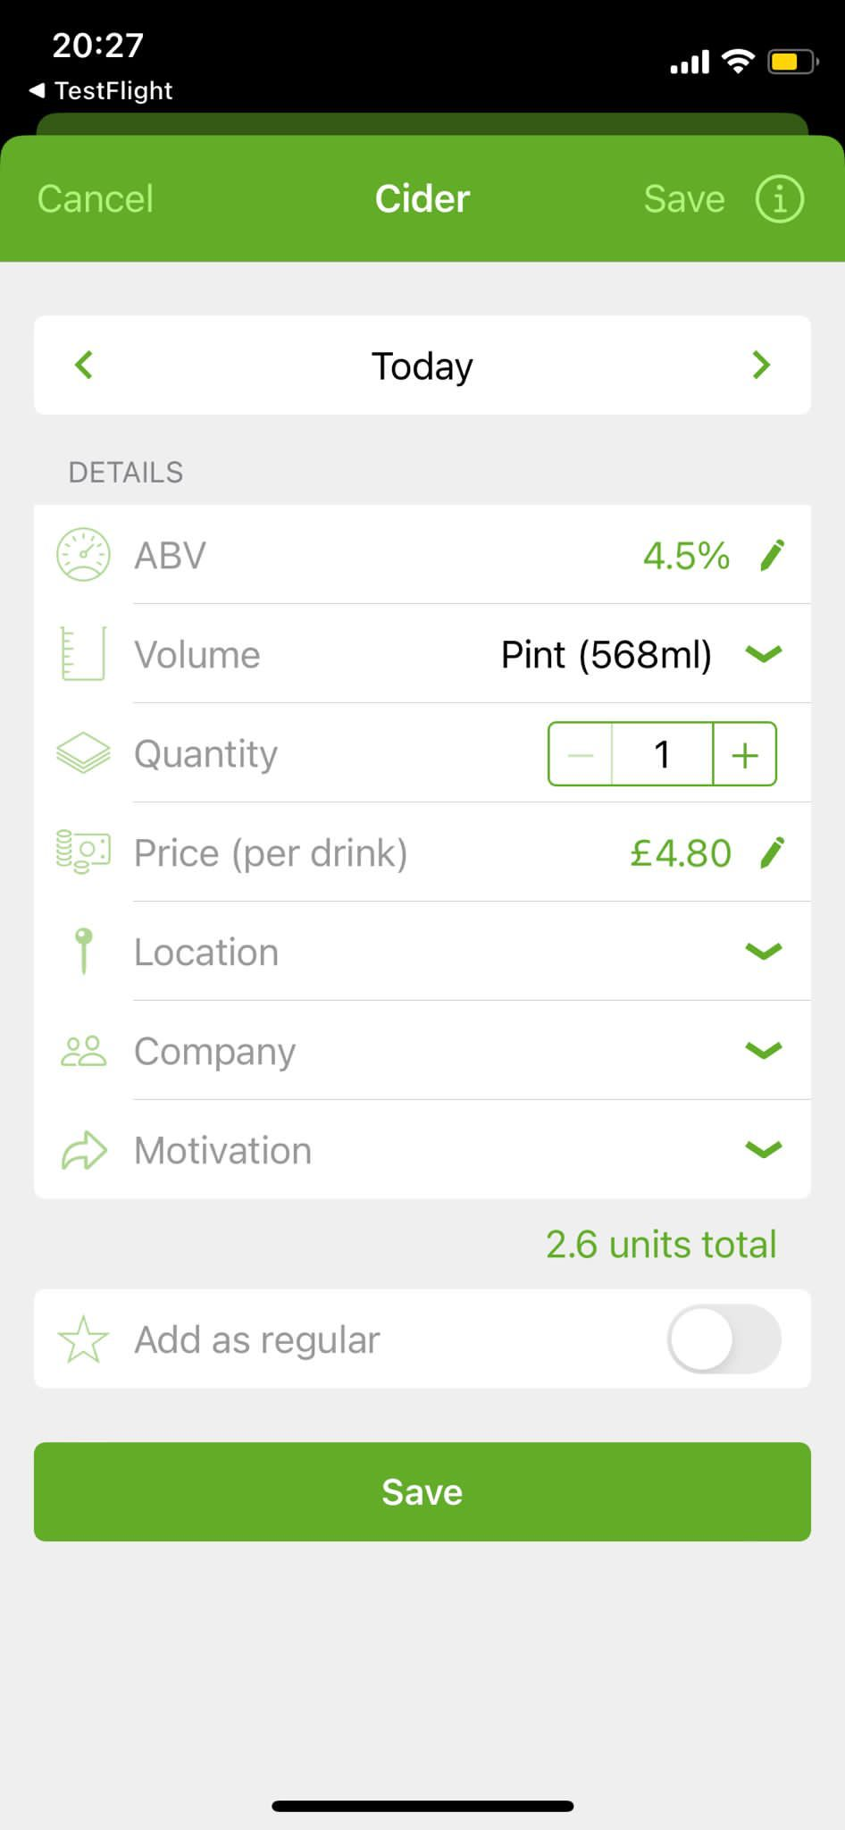
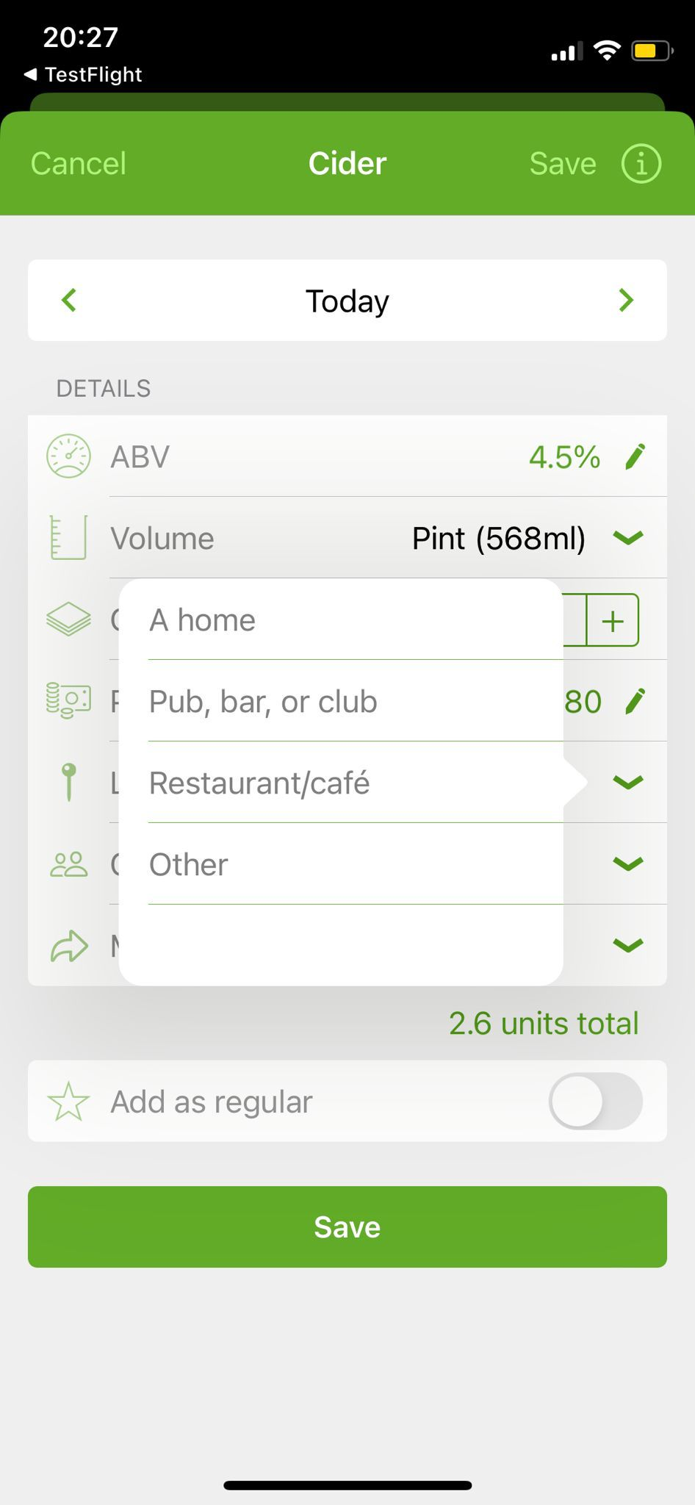
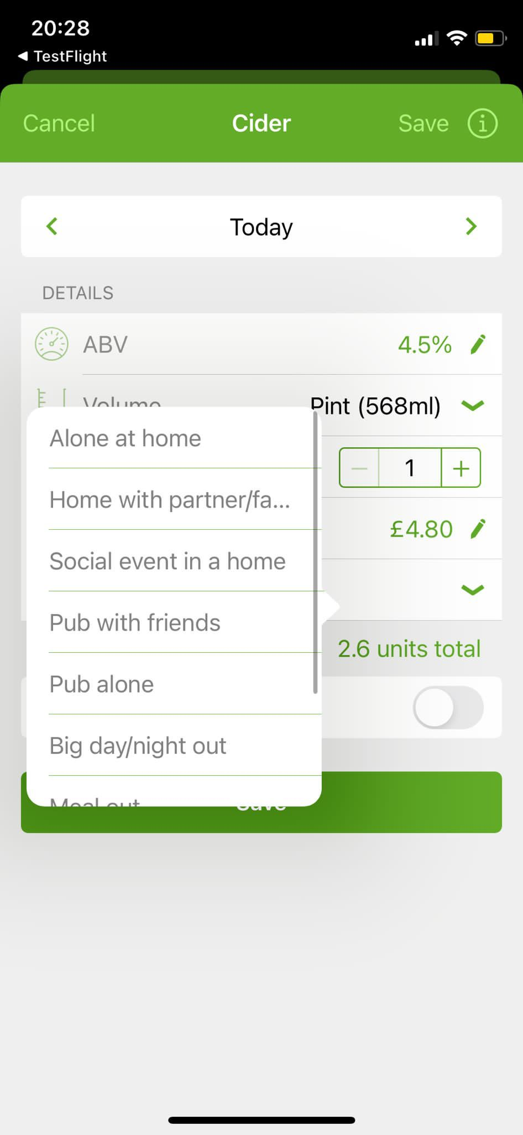
WP1 – Comparing two methods of collecting context information in diary
Version 1
Version 2
Notes:
First I would like to acknowledge Dr Abigail Stevely at University of Sheffield who led this work package.
With digital interventions there is often a trade off between collecting enough detail to provide tailored feedback and losing people if an intervention is too burdensome. As such we decided to start off by testing two versions of the app. Version 1 was more tailored, it allowed people to select their location, company and motivation from a list. Version 2 was quicker but less tailored. We had people select the occasion which was most like the one they had drank in and this list was based on those most prevalent types of occasions I mentioned earlier.

Slide 15
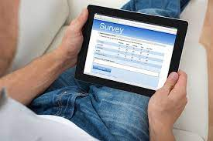
WP1 – Comparing two methods of collecting context information in diary
Notes:
We recruited 62 people to use one of these versions for two weeks.
After this, 61 completed a usability survey focused specifically on the drinking diary.
We also interviewed 16 people and asked them about how acceptable they found the drinking diary.
There was very little difference between the two groups in terms of either usability or acceptability. As such we decided to go with the SIMPLEST option.

Slide 16
Aim 2 – Context-specific intervention messaging
Notes:
So this brings us to the second aim – developing contextually specific intervention components.

Slide 17
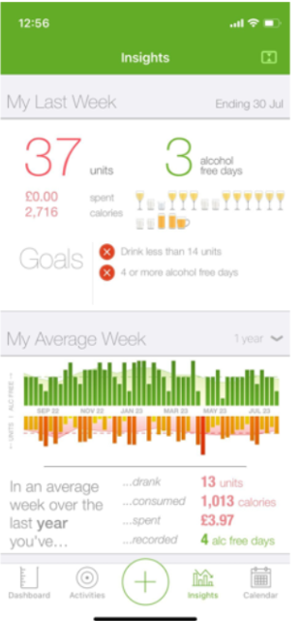
Feedback component currently looks like….….
Notes:
We will start with the feedback component as it is the simplest. It currently looks like this…

Slide 18
Contextually-specific feedback component intervention messaging….
When you drink more than 6 units in one day you tend to be in occasion X
When you drink more than 3 drinks a day you tend to be in occasion X
When you have a red day* you tend to be in occasion X
When you do not meet your goal/s you tend to drink in occasions X
Notes:
SO we have been developing different ways of providing feedback on the contexts in which people drink.
This is oriented to the goals that people set. Most people set consumption goals in terms of units, but some set goals around alcohol free days, money spent or calories consumed.

Slide 19
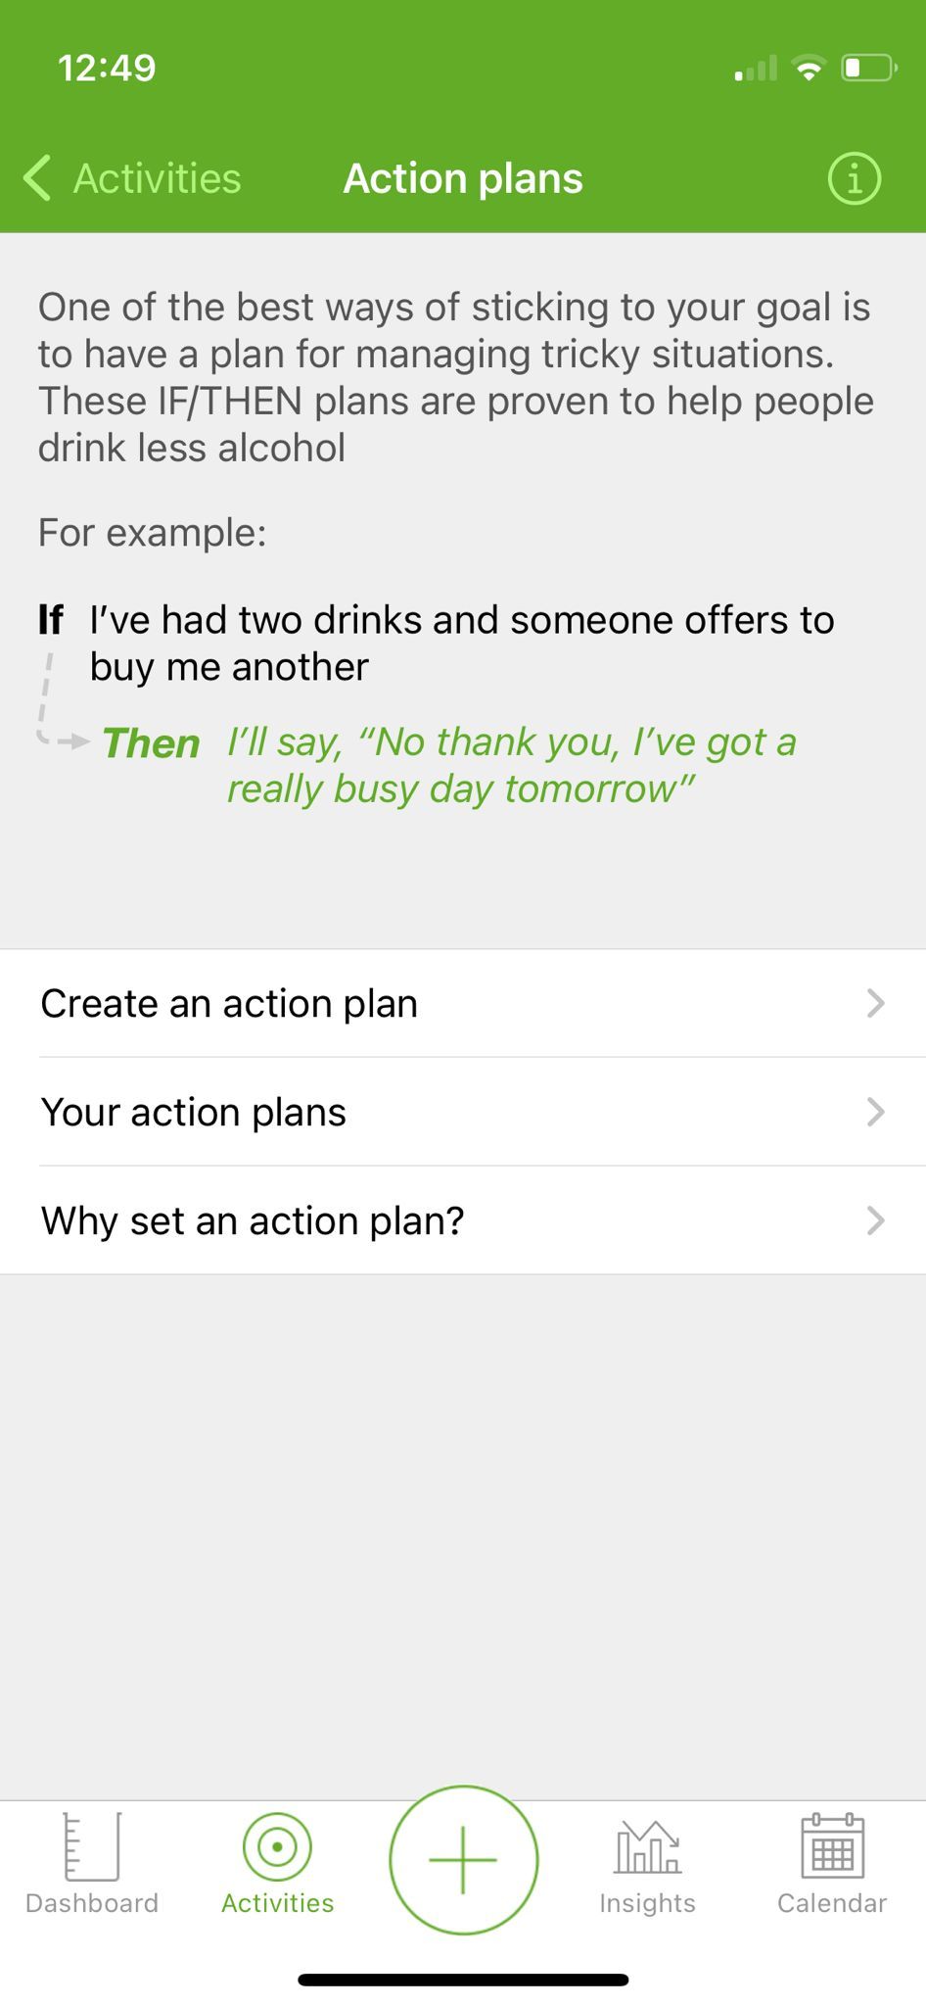
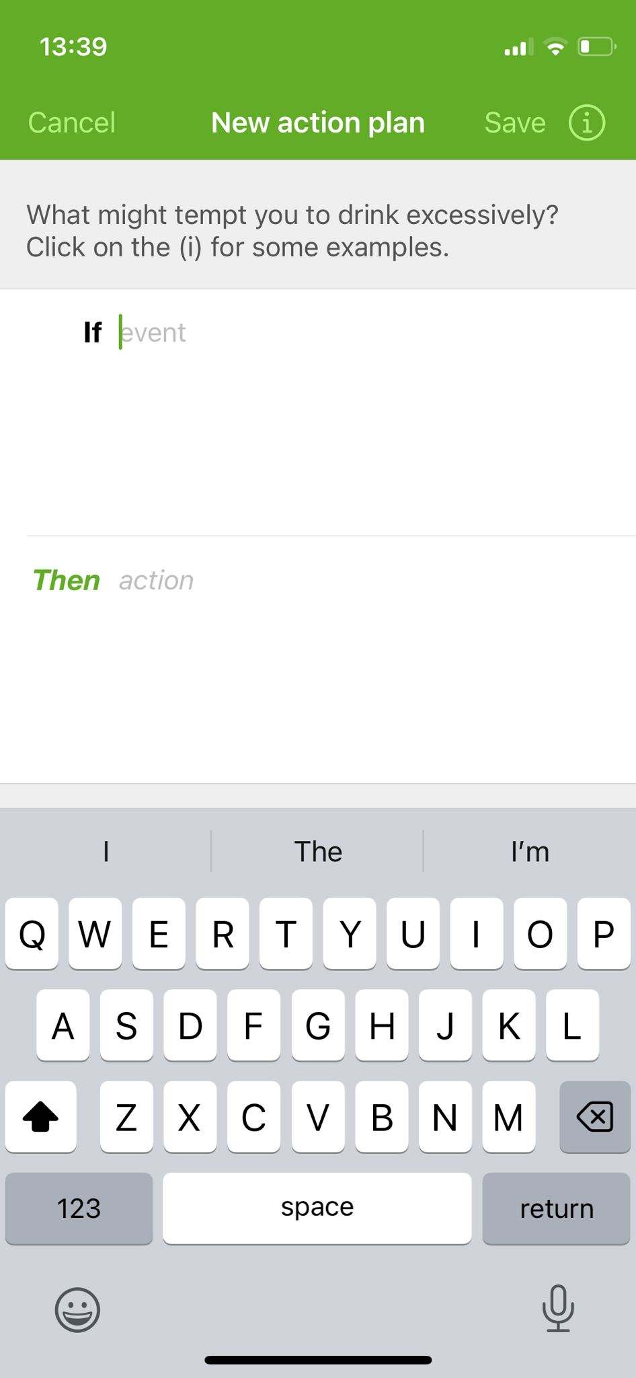
Action planning component currently looks like….
Notes:
The action planning component is a little less simple but more interesting I think. So currently people make if then plans for what they will do. The evidence shows that the more specific these are the more helpful they will be to people.
So we used the behaviour change technique framework to develop advice for people drinking in different contexts.

Slide 20
Contextually-specific action planning component…. Pub with friends
I will avoid rounds so I can drink at my own pace and don’t feel pressured to drink.
I will tell my friends in advance that I won’t be drinking more than x drinks and ask them to help me stick to it
I will keep a glass or bottle of something non-alcoholic in my hand, so its less likely I’ll be offered alcoholic drinks.
I will order a soft drink between each alcoholic drink

Slide 21
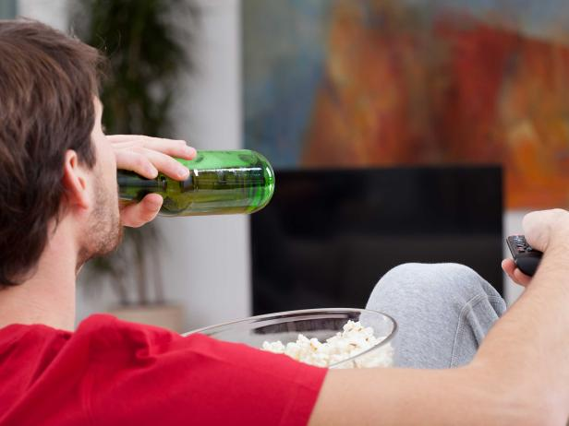
Contextually-specific action planning component…. Alone at home
I will avoid buying alcohol to drink at home. I will spend the money I save on [].
I’ll only buy the alcohol I want to drink that day.
I will keep nice soft drinks or alcohol-free drink options in the house for when I fancy an alcoholic drink.
I will store alcohol in less visible places in my home, such as the back of a cupboard, to reduce temptation.
I will use smaller glasses or measure out alcoholic drinks to help me drink less.

Slide 22
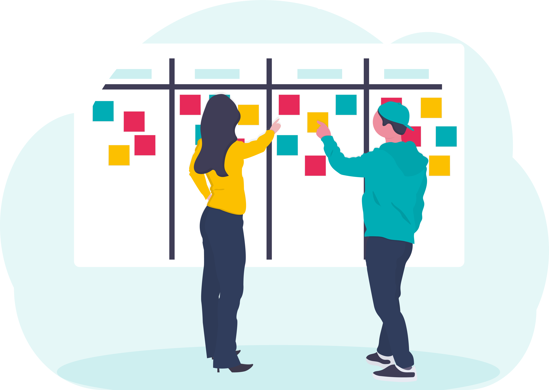
Next Steps….
Focus Groups with increasing-and-higher-risk drinkers
Think Aloud studies
App developer interview
Notes:
The next steps are to test this messaging with increasing and higher risk drinkers to make sure it is clear. We will do some creative sessions within the focus grops such as card sorting tasks where participants will be asked to do card sorting tasks to rank the messaging in terms of what is most helpful to least helpful in different scenarios.
We will then run think aloud studies with a number of potential app users where they will use mock ups of the intervention messaging and will rank how useful the messaging is.

Slide 23
Questions?

